Slide 1
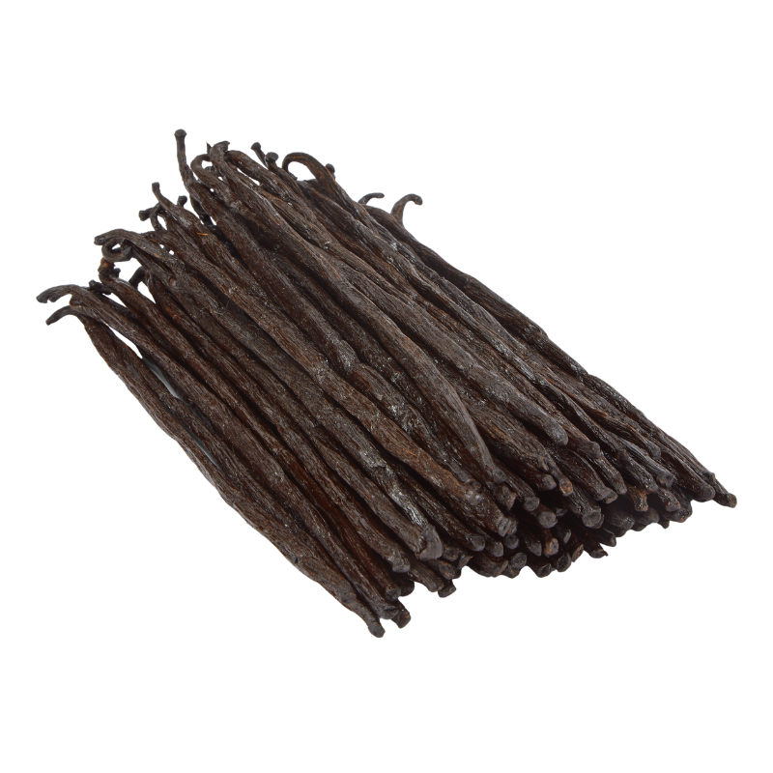
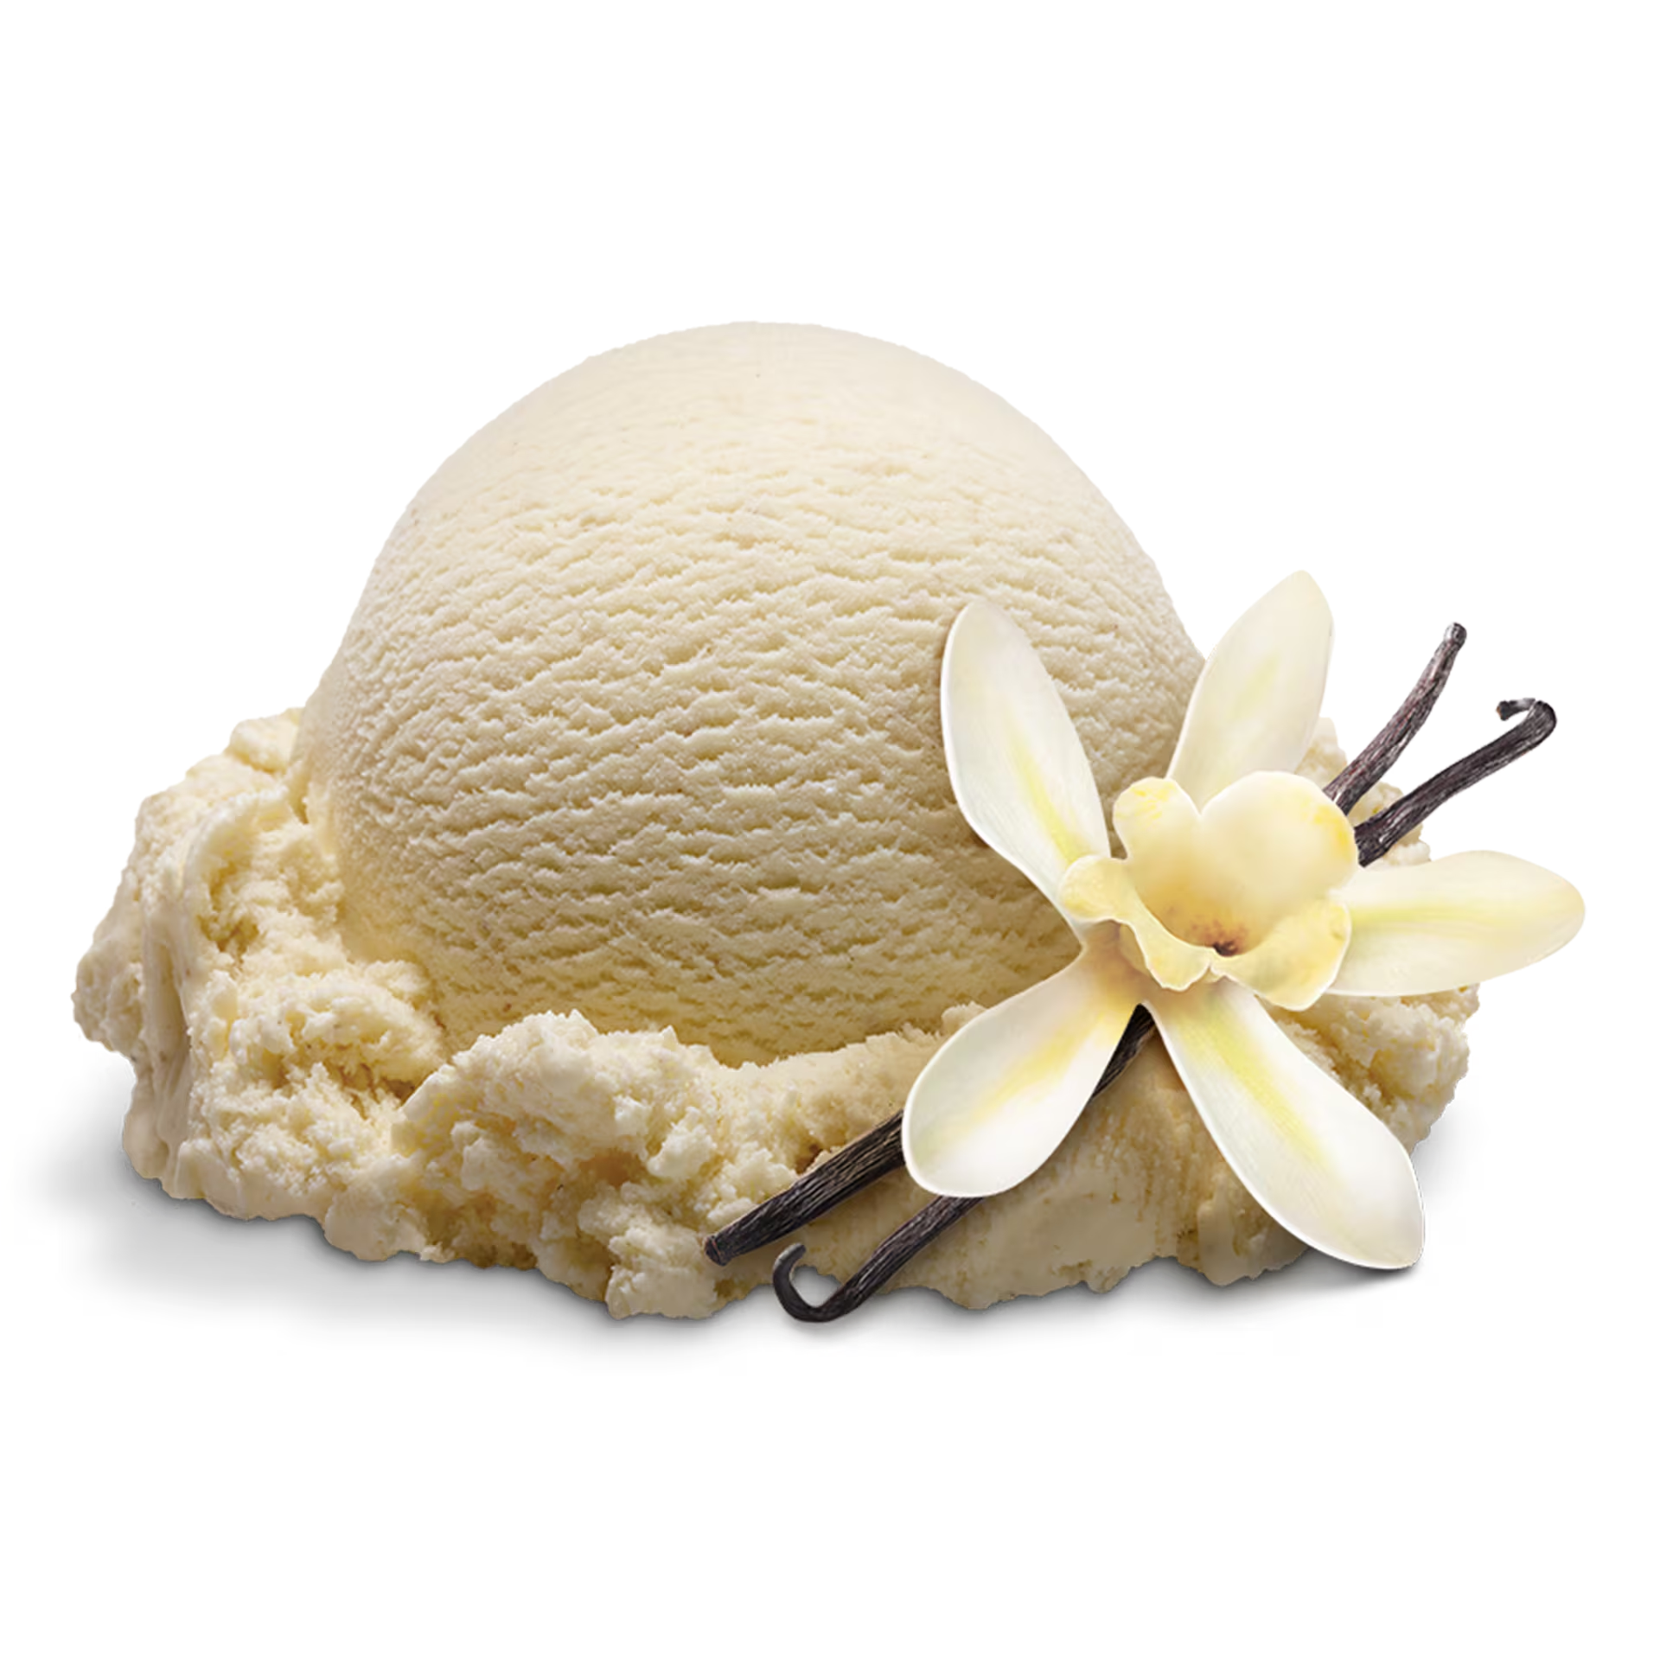
Vanilla & Spices
Seth Boutilier

Slide 2

Case Profile
Madagascar which supplies roughly 80% of the world’s vanilla, employs over 20,000 children to produce vanilla and other spices like cloves. Ethically sourced vanilla and spices can cost between 20% and 80% more than the standard products.

Slide 3

Ethical Priming
In order to sell a product of equal quality for a higher price, it would greatly beneficial for the customer to feel like they are taking the ethical high road by choosing the more expensive product. By taking a transparent approach and showing what farms the vanilla/spices are coming from, and who they are supporting, customers will feel more inclined to support them despite the higher price.

Slide 4

Highlighting Fair Trade Advantages
No child labor: Organizations that produce vanilla and spices in Madagascar for lower prices, use children to reduce their labor costs.
Living Wages / Fair Payment: The more expensive product is paying workers adequately for their labor, rather than relying on cheap foreign labor.
The more expensive product’s company has more reasonable shifts, and does not force their employees to work without gloves or lung protection for pesticides.

Slide 5
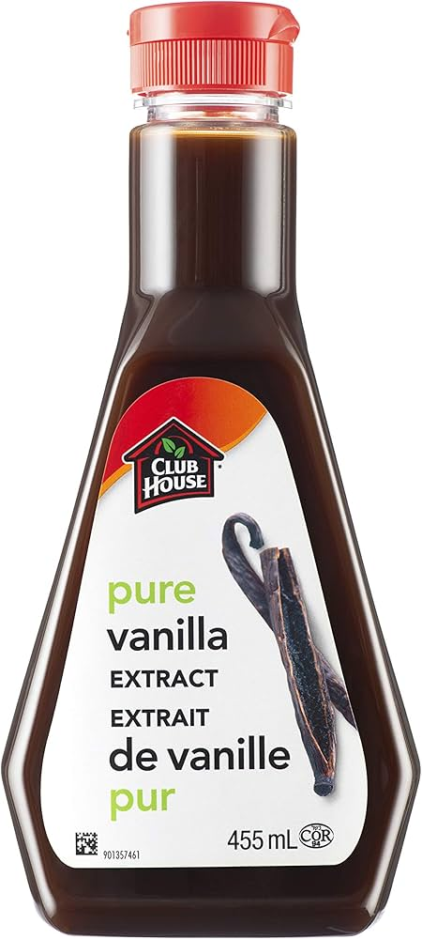
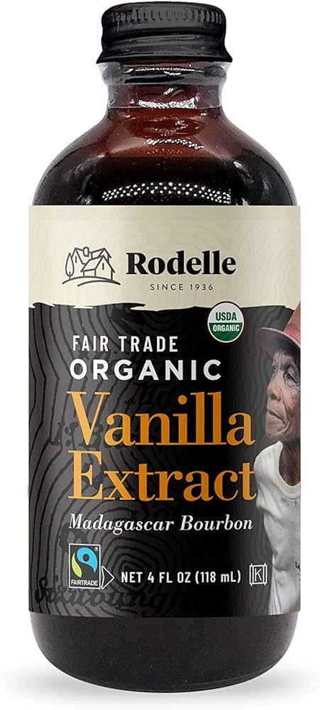
The Pitch
Made by a sweet elderly Madagascaranese lady, who works short shifts and gets paid well above minimum wage and works in a safe environment. $32.00.
Made by poor African children who get paid unlivable wages for extremely difficult labor. $18.00.

